Slide 1
Verification mehtods for vlsi design
Masrur jamil prochchhod
Id-2210028

Slide 2
motivation
Increasing Complexity of VLSI Designs
Critical Industry Relevance
Advances in Verification Technologies

Slide 3
introduction
What is VLSI Design?
VLSI (Very Large Scale Integration) involves designing integrated circuits by combining thousands to millions of transistors into a single chip.
It is a key enabler of compact, high-performance, and energy-efficient electronic devices
Importance of Verification in VLSI
Ensures functionality, performance, and reliability of complex VLSI designs before fabrication.
Plays a critical role in detecting and addressing errors early in the design process, reducing costs and time-to-market.

Slide 4
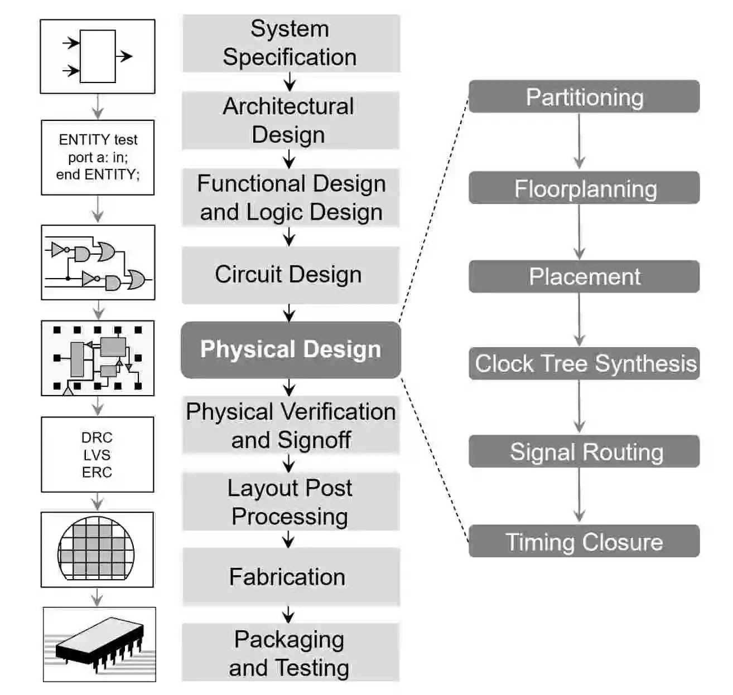
Overview of vlsi design flow
System Specification
Architectural Design
Function and Logic Design
Circuit Design
Physical Design
Physical Verification
Fabrication
Packaging and Testing
1

Slide 5
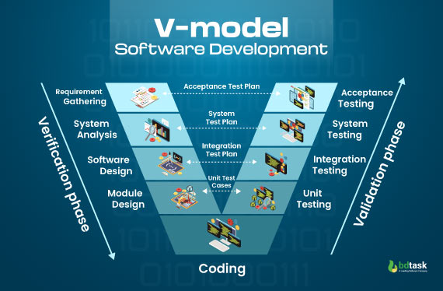
V Model
2

Slide 6
Verification methodologies in vlsi design
Simulation Based Verification
Formal Verification
Emulation Based Verification
Static Verification
Post-Silicon Verification

Slide 7
Industry Standards in Verification
IEEE 1800 (System Verilog)
Universal Verification Methodology (UVM)

Slide 8
Verification Analysis and Key Metrics in VLSI Design
Code Coverage
Functional Coverage
Timing Analysis

Slide 9
Impact of Verification on Design Quality and Efficiency
Cost Savings
Product Reliability
Time to time market

Slide 10
Summary
Verification ensures that VLSI circuits function correctly, meet performance standards, and adhere to power, timing, and area constraints.
V Model provides a structured and systematic approach to verification.
Standards like IEEE 1800 (SystemVerilog) and UVM enable scalable and reusable verification workflows.
Verification ensures manufacturable, reliable, and efficient designs.

Slide 11
References
https://www.themechatronicsblog.com/2023/04/vlsi-design-%20a-complete-overview-of-the-vlsi-design-flow.html
https://www.bdtask.com/blog/v-model-in-software-development
https://www.researchgate.net/publication/234290920_Verification_of_VLSI_designs
ieeexplore.ieee.org/document/5390530
www.design-reuse.com/articles/54702/importance-of-vlsi-design-verification-and-its-methodologies.html
internationalpubls.com/index.php/anvi/article/view/1444

